Slide 1
CIT 2017 Template Title 40 pt Bold Arial
David Liu, MD
Subtitle 34 pt Arial Bold Italics

Slide 2
Disclosure Statement of Financial Interest
Within the past 12 months, I or my spouse/partner have had a financial interest/arrangement or affiliation with the organization(s) listed below.
Affiliation/Financial Relationship
Company
Grant/Research Support
Consulting Fees/Honoraria
Major Stock Shareholder/Equity
Royalty Income
Ownership/Founder
Intellectual Property Rights
Other Financial Benefit
Company Names
Company Names
Company Names
Company Names
Company Names
Company Names
Company Names

Slide 3
Disclosure Statement of Financial Interest
I, (insert name) DO NOT have a financial interest/arrangement or affiliation with one or more organizations that could be perceived as a real or apparent conflict of interest in the context of the subject of this presentation.

Slide 4
Text Slide – Titles
Gold text can be used as a highlight color
No text shadows on any text
Italics are better to emphasize words rather than underline
Line spacing should be 1 Line with 0.3 before each paragraph
Set the slide transition to wipe right
Remove unnecessary animations
Notes:
3
This is the Bulleted List slide.
To create this particular slide, click the NEW SLIDE button on your toolbar and choose the BULLETED LIST format. (Top row, second from left)
The Sub-Heading and footnote will not appear when you insert a new slide. If you need either one, copy and paste it from the sample slide.
If you choose not to use a Sub-Heading, let us know when you hand in your presentation for clean-up and we’ll adjust where the bullets begin on your master page.
Also, be sure to insert the presentation title onto the BULLETED LIST MASTER as follows:
Choose View / Master / Slide Master from your menu.
Select the text at the bottom of the slide and type in a short version of your presentation title.
Click the SLIDE VIEW button in the lower left hand part of your screen to return to the slide show. (Small white rectangle)

Slide 5
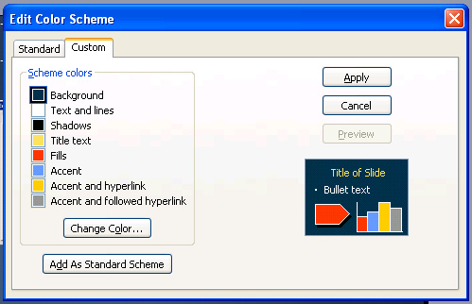
Color Palette
Use these colors to format all elements in the file including charts, graphic elements and tables
PPT Color Scheme |  | R | G | B
Background |  | 0 | 46 | 75
Text and lines |  | 255 | 255 | 255
Shadows |  | 0 | 0 | 0
Title text |  | 255 | 226 | 94
Fills |  | 255 | 51 | 0
Accent |  | 102 | 153 | 255
Accent and hyperlink |  | 255 | 204 | 0
Accent and followed hyperlink |  | 150 | 150 | 150
Grube E. et al, Am Journal Cardiol 2006; “in press”

Slide 6
Charts Slide
Subtitle text 30 pt Bold Ital
p = 0.125
p = NS
p = 0.001
Note: References should be 14pt Arial bold with the Journal title in Italics
Grube E. et al, Am Journal Cardiol 2006; “in press”
Notes:
5
This is the Bulleted List slide.
To create this particular slide, click the NEW SLIDE button on your toolbar and choose the BULLETED LIST format. (Top row, second from left)
The Sub-Heading and footnote will not appear when you insert a new slide. If you need either one, copy and paste it from the sample slide.
If you choose not to use a Sub-Heading, let us know when you hand in your presentation for clean-up and we’ll adjust where the bullets begin on your master page.
Also, be sure to insert the presentation title onto the BULLETED LIST MASTER as follows:
Choose View / Master / Slide Master from your menu.
Select the text at the bottom of the slide and type in a short version of your presentation title.
Click the SLIDE VIEW button in the lower left hand part of your screen to return to the slide show. (Small white rectangle)

Slide 7
Table Slide
Subtitle text 30 pt Bold Ital
 | DCA n = 381 | Stent n = 372 | P Value
Late loss (mm) | 25.0 | 13.0 | 0.28
Binary restenosis | 26.7 | 22.1 | 0.24
- Optimal DCA (%) | 16.2 | 22.1 | 0.39
- TVR | 25.0 | 23.0 | 21.0
12-Month TVF (death, MI, TVR) (%) | 23.9 | 21.5 | 0.48
Grube E. et al, Am Journal Cardiol 2006; “in press”

Slide 8
Sample Org Chart
Design
139 patients enrolled between July and December 2004 in 13 clinical sites in Europe, South America and New Zealand
DESIGN: Prospective, non-randomized, single-arm, multi-center clinical evaluation of the AXXESSTM Plus Bifurcated Coronary Stent System
OBJECTIVE: To evaluate the acute and long-term safety, tolerability and performance of the AXXESS Plus stent
PRINCIPAL INVESTIGATOR Eberhard Grube, MD Helios Heart Center, Egburg, Germany
3 patients not stented
136 patients with AXXESS conical stent implanted
Clinical follow-up at 6 months in 99.3% (N=135)
Angiographic follow-up at 6 months in 92.6% (N=126)
Clinical follow-up at 12 months in 96.3% (N=131)

Slide 9
Sample Line Chart
Subtitle text 30 pt Bold Ital
Axis Title
P<0.001
Notes:
This is the Sample Column Chart slide.
To create this particular slide, copy and paste the sample in the Slide Sorter view as follows:
Select View / Slide Sorter
Highlight the Sample Column Chart page and select Edit / Copy
Place the courser where you want the new slide to be and select Edit / Paste
Double-click on the pasted-in slide to return to Slide view
To access the column chart, right/click on the chart and select chart object / open from the menu. This will open the chart in Microsoft Graph. You can make any changes to the chart and spreadsheet here.
When you are finished making your changes, select File / Exit and return to… from the menu bar.
THIS METHOD IS PREFERRED TO DOUBLE-CLICKING THE GRAPH AND OPENING IT IN POWERPOINT. Double-clicking the graph can sometimes reformat the sizes, colors, animations and fonts in your graph.

Slide 10
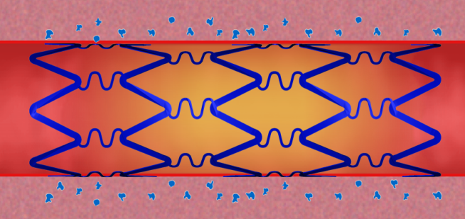
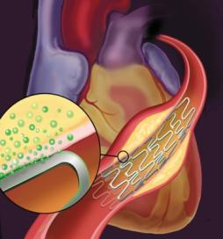
Photos & Bulleted Text
Text here
Text here
Text here
Text here
Text here
Text here

